Slide 1
Behavior Database Tool
Megan Meade
TIE 533
June 2012

Slide 2
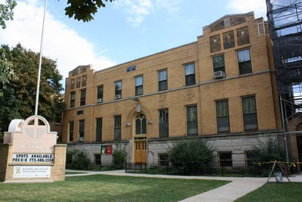
Saint John Berchmans
http://www.stjohnberchmans.org/

Slide 3
Behavior Database
Input the following:
Name
Date
Location
Behavior Level (by color)
Description of Incident
Resolution
Suggestions for Further Action
Option: Mediating Sessions, Circle Times, Discussions, etc.

Slide 4
Behavioral Level Chart
Exemplary | Ready to Learn | Level 1 | Level 2 | Level 3
-Made good choices and helped others | -Followed all rules and expectations -Made safe and responsible choices | -Interrupting teacher or fellow student -Displaying anger or frustration inappropriately -Used negative actions or words -Showing disrespect towards teacher or another student | -Repeated level 1 behaviors -Showing physical aggression -Inappropriate language -Making unsafe choices -Not following school rules -Dishonesty | -Repeated level 2 behaviors -Stealing -Vandalism -Violence -Threats

Slide 5
Resources
Jeccalouise. (2008, September 10). Behavior Database Instruction. http://www.youtube.com/watch?v=32CHWpIkUgM
Microsoft Office. (2010). Access 2010. Retrieved from http://office.microsoft.com/en-us/access/what-is-microsoft-access- database-software-and-applications-FX102473444.aspx
Ricciardi, Sal. Microsoft Office. (2003). Using Parameters with Queries and Reports. Retrieved from http://office.microsoft.com/en-us/access- help/using-parameters-with-queries-and-reports-HA001117077.aspx

